Slide 1
NEAR OPTIMAL FEEDBACK GUIDANCE DESIGN AND THE PLANAR RESTRICTED THREE-BODY PROBLEM
Roberto Furfaro, Joseph Dinius, Francesco Topputo and Scott Selnick
AAS 14-238

Slide 2
Outline of the Talk
Motivation
The Planar-Restricted Three-Body Problem (PR3BP)
Optimization of Spacecraft Trajectories using open-loop techniques
Shortcomings
Supplementing with feedback control
The ZEM/ZEV guidance law
Results
Summary and Future Work

Slide 3
Motivation
Existing techniques for spacecraft trajectory design utilize collocation methods and nonlinear programming to optimize given a desired constraint
Open-loop, which assumes perfect knowledge (negligible modeling, navigation and sensor uncertainties)
The underlying dynamical systems governing trajectories are nonlinear
Small initial errors grow exponentially over time (Lyapunov instability)
Adding feedback control to supplement open-loop optimization can be used to control the growth of errors

Slide 4
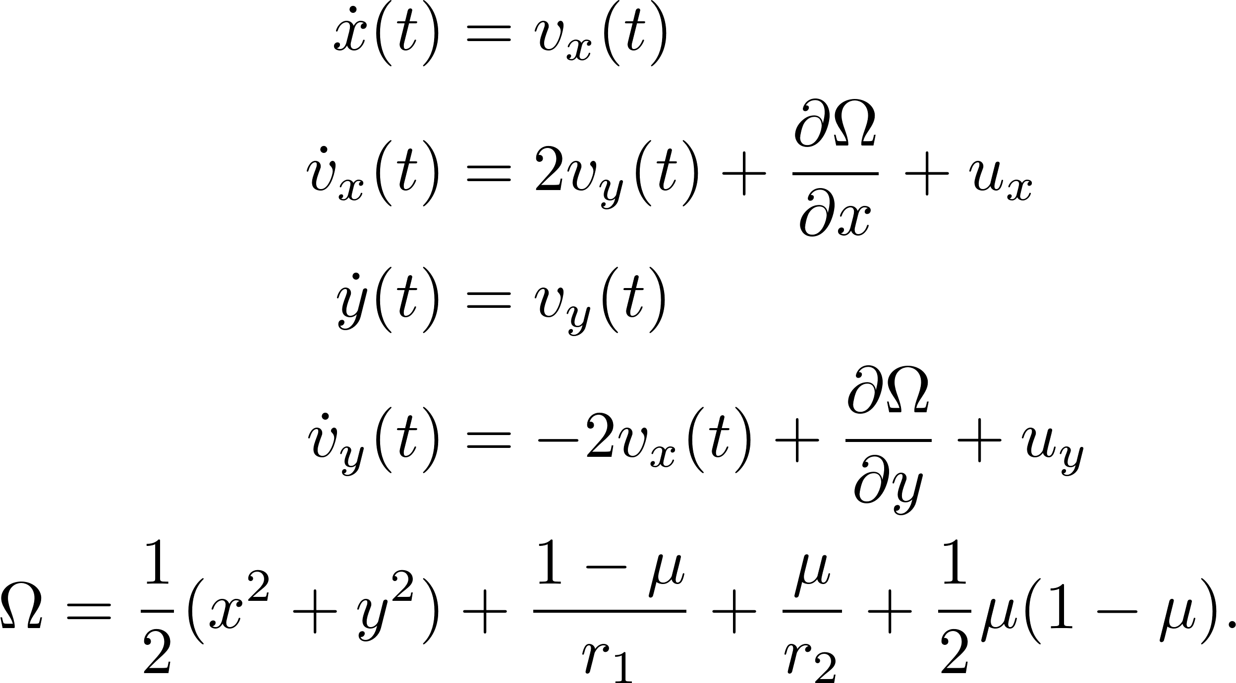
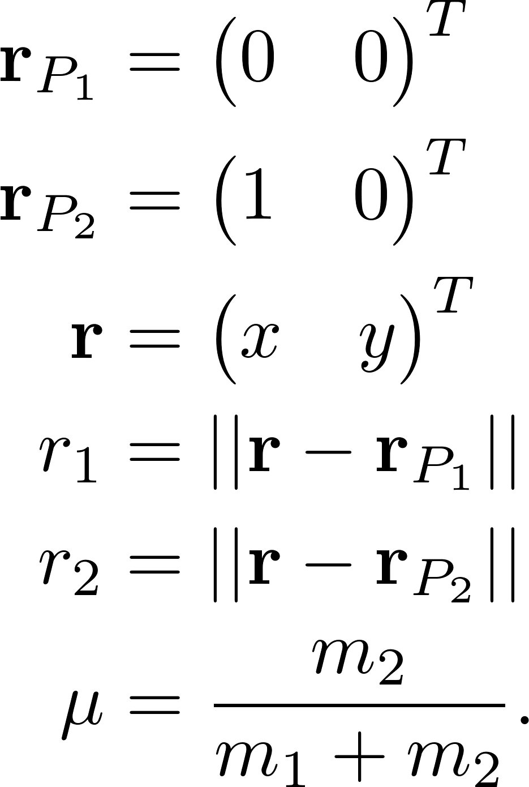
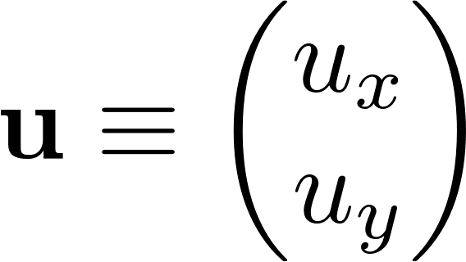
The PR3BP
The planar-restricted three body problem (PR3BP)
With control input
Notes:
The chosen coordinate frame is the synodic-frame, the one that is co-rotating with the system-center of mass. Normalized units are used such that the distance between the bodies is unity. Mass of a third body (the spacecraft) is negligible with respect to the primaries. The vector r represents the position of the third body. The system to be discussed later is the Earth-Moon system.

Slide 5
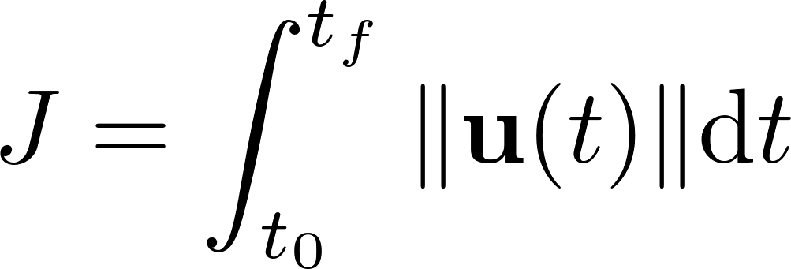
Open-Loop Trajectory Design (OLTD)
Optimization of spacecraft trajectories generates a time-history of the control u from the previous slide which minimizes fuel-consumption
Many techniques exist for performing the optimization
Gauss-Lobatto quadrature
Parallel shooting
Etc…

Slide 6
Shortcomings of Open-Loop Design
Assumes perfect fidelity of underlying dynamics model
Assumes perfect sensing and navigation
There is no capability to dynamically track and zero out errors
Due to the underlying nonlinear nature of the equations of motion, even “optimal” trajectories can diverge far from desired insertion states

Slide 7
Supplementing OLDT with Feedback Control
The fuel optimal control law generated from open-loop optimization can be used for coarse control of trajectories
Dynamic feedback allows for fine correction on shorter timescales
The strategy becomes
Use fuel optimal control history sufficiently close to desired inertial states (position and velocity)
When errors observed between desired and achieved trajectories exceed threshold, use feedback guidance law to zero out the error
Notes:
The term “shorter” means shorter relative to the total trajectory time.

Slide 8
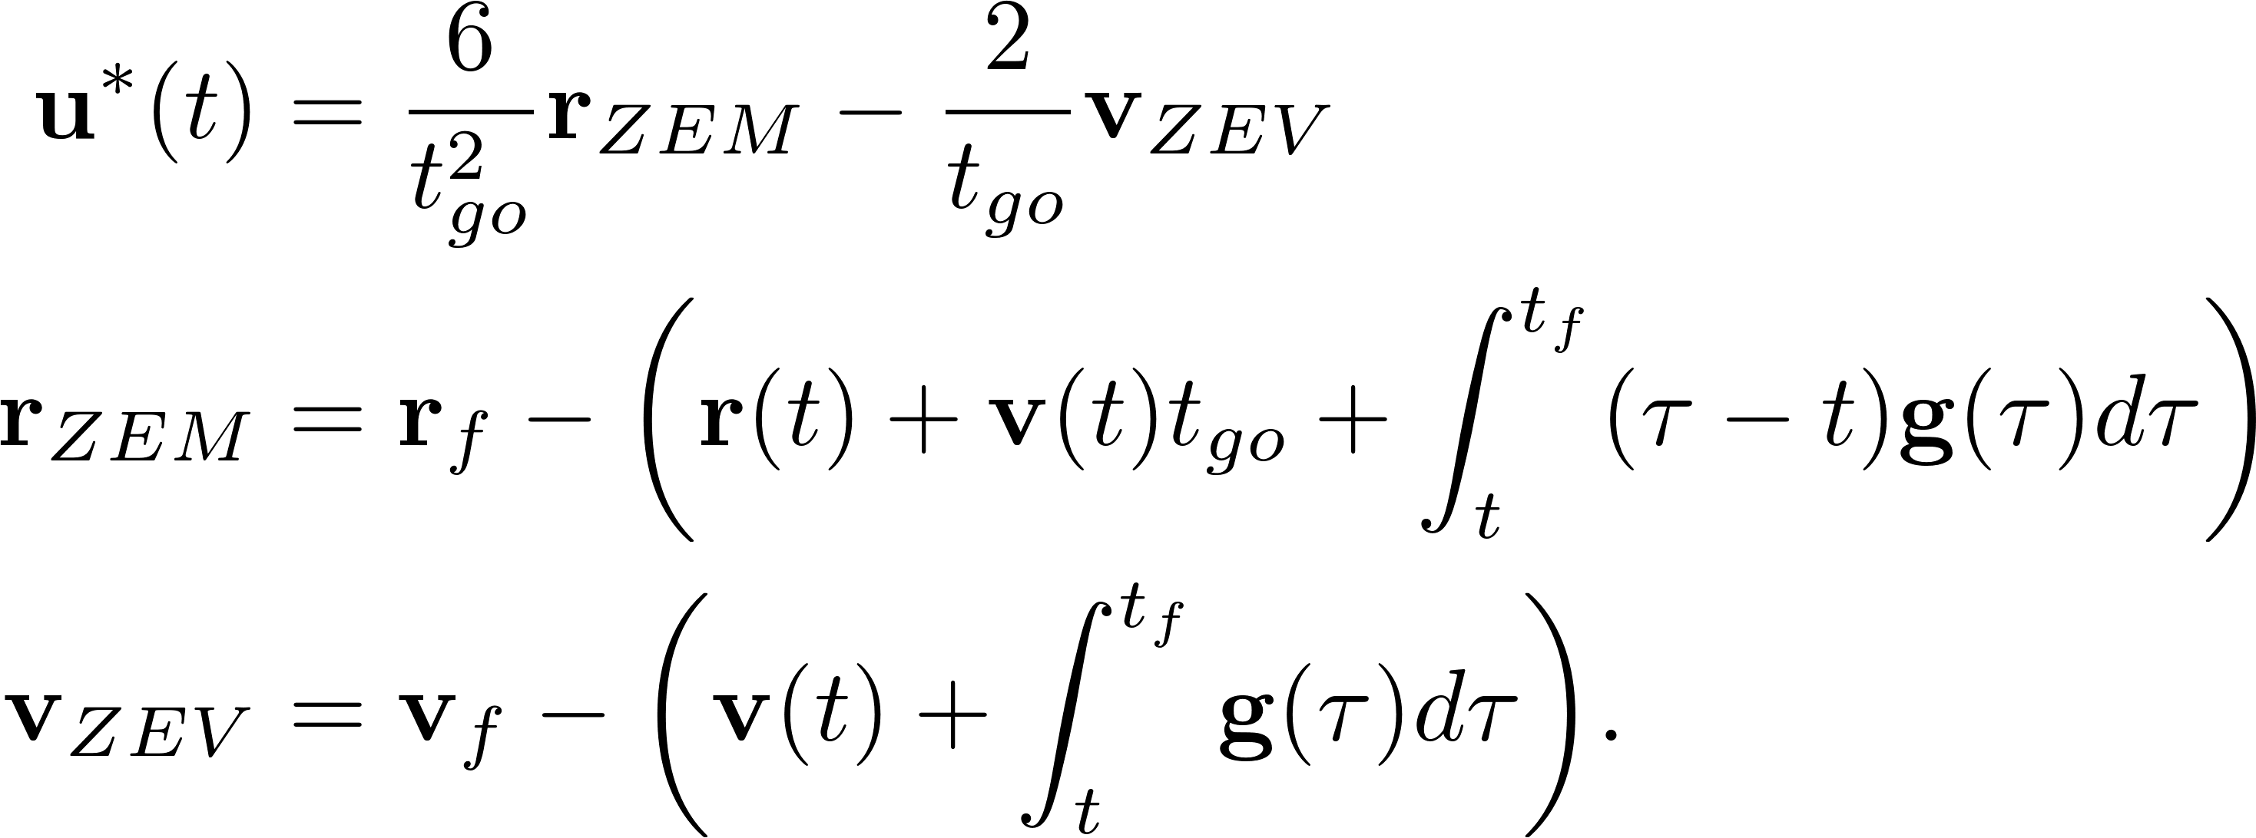
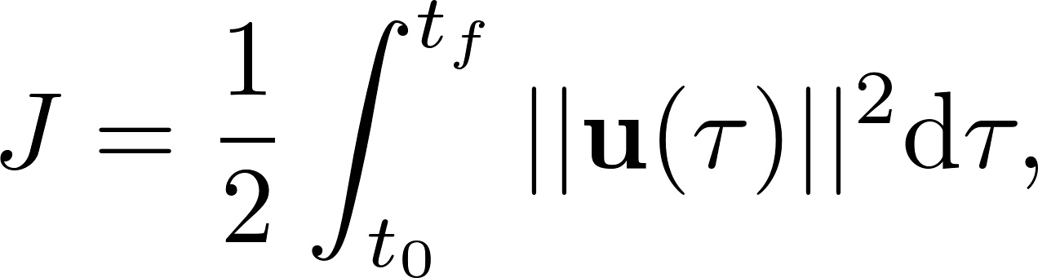
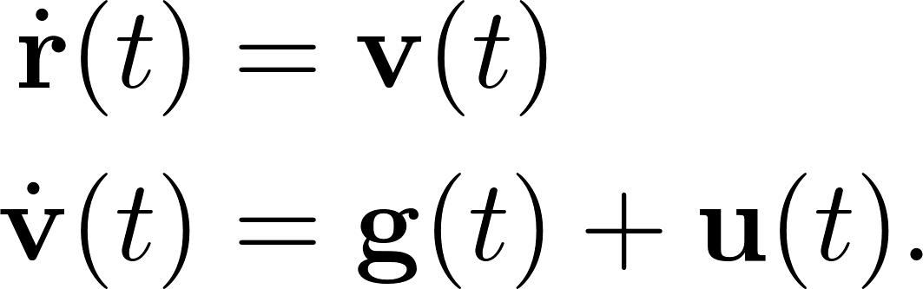
ZEM/ZEV as an Optimal Guidance Law
What feedback law should be used?
Well, the optimal one, of course…
The ZEM/ZEV guidance law
minimizes the performance index
for the following control objective

Slide 9
ZEM/ZEV and Optimality for the PR3BP
ZEM/ZEV is not, strictly speaking, optimal for the PR3BP
Gravity g is not explicitly a function of time
However, gravity can be represented as a function of time through the numerical integration along a trajectory

Slide 10
Results and Comparison with OLDT: GTO to L₁ Lyapunov Transfer
Fuel Optimal Thrust Profile
ZEM/ZEV vs. Fuel Optimal
Notes:
Blue circle is the starting point for ZEM/ZEV (waypoint). Challenge becomes how/when to employ waypoint optimization for utilizing ZEM/ZEV. Left: Red asterisks indicate points along the trajectory where thrust profile is being used. Control strategy for left is bang-bang (on-off). Right: comparison between fuel optimal, no control and ZEM/ZEV show that ZEM/ZEV drives the system to the desired state from the waypoint at the blue circle.

Slide 11
ZEM/ZEV Minimizes Cumulative Acceleration Effort, Not Fuel Usage
Acceleration Profile
Fuel Consumption

Slide 12
Summary and Future Work
Open-loop optimization methodologies work, but what about in the presence of unmodeled errors?
ZEM/ZEV provides a guidance solution for in-flight course corrections
Future Work
Prove robustness of ZEM/ZEV
Combine with sliding mode control scheme
Determine optimal strategy for deployment (error thresholds and waypoint selection)

Slide 13
BACKUP

Slide 14
Two-dimensional slices of 4-D phase space for comparison
Phase plane slice: vx vs. x
Phase plane slice: vy vs. y

Slide 15
Fuel optimal thrust history

